Slide 1
Knowledge Representation
Knowledge engineering: principles and pitfalls
Ontologies
Examples

Slide 2
Knowledge Engineer
Populates KB with facts and relations
Must study and understand domain to pick important objects and relationships
Main steps:
Decide what to talk about
Decide on vocabulary of predicates, functions & constants
Encode general knowledge about domain
Encode description of specific problem instance
Pose queries to inference procedure and get answers

Slide 3
Knowledge engineering vs. programming
Knowledge Engineering Programming
Choosing a logic Choosing programming language
Building knowledge base Writing program
Implementing proof theory Choosing/writing compiler
Inferring new facts Running program
Why knowledge engineering rather than programming?
Less work: just specify objects and relationships known to be true, but leave it to the inference engine to figure out how to solve a problem using the known facts.

Slide 4
Properties of good knowledge bases
Expressive
Concise
Unambiguous
Context-insensitive
Effective
Clear
Correct
…
Trade-offs: e.g., sacrifice some correctness if it enhances brevity.

Slide 5
Efficiency
Ideally: Not the knowledge engineer’s problem
The inference procedure should obtain same answers no matter how knowledge is implemented.
In practice:
- use automated optimization
- knowledge engineer should have some
understanding of how inference is done

Slide 6
Pitfall: design KB for human readers
KB should be designed primarily for inference procedure!
e.g.,VeryLongName predicates:
BearOfVerySmallBrain(Pooh) does not allow inference procedure to infer that Pooh is a bear, an animal, or that he has a very small brain, …
Rather, use:
Bear(Pooh)
b, Bear(b) ⇒ Animal(b)
a, Animal(a) ⇒PhysicalThing(a)
…
[See AIMA pp. 220-221 for full example]
In other words:
BearOfVerySmallBrain(pooh) = x(pooh)

Slide 7
Debugging
In principle, easier than debugging a program,
because we can look at each logic sentence in isolation and tell whether it is correct.
Example:
x, Animal(x) ⇒ ∃ b, BrainOf(x) = b
means
“there is some object that is the value of the BrainOf function applied to an animal”
and can be corrected to mean
“every animal has a brain”
without looking at other sentences.

Slide 8
Ontology
Collection of concepts and inter-relationships
Widely used in the database community to “translate” queries and concepts from one database to another, so that multiple databases can be used conjointly (database federation)

Slide 9
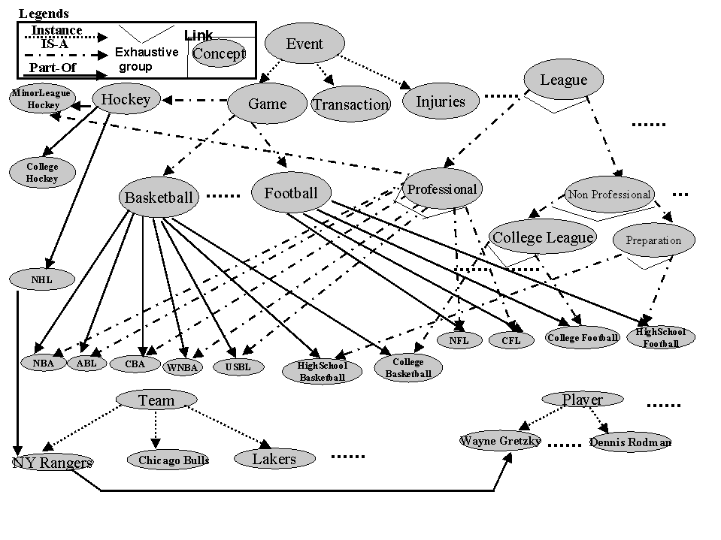
Ontology Example
Khan & McLeod, 2000

Slide 10
Towards a general ontology
Develop good representations for:
categories
measures
composite objects
time, space and change
events and processes
physical objects
substances
mental objects and beliefs
…

Slide 11
Representing Categories
We interact with individual objects, but…
much of reasoning takes place at the level of categories.
Representing categories in FOL:
- use unary predicates
e.g., Tomato(x)
- reification: turn a predicate or function into an object
e.g., use constant symbol Tomatoes to refer to set of all tomatoes
“x is a tomato” expressed as “x∈Tomatoes”
Strong property of reification: can make assertions about reified category itself rather than its members
e.g., Population(Humans) = 5e9
-in a table form (small set of objects)
-based on its properties

Slide 12
Categories: inheritance
Allow to organize and simplify knowledge base
e.g., if all members of category Food are edible
and Fruits is a subclass of Food
and Apples is a subclass of Fruits
then we know (through inheritance) that apples are edible.
Taxonomy: hierarchy of subclasses
Because categories are sets, we handle them as such.
e.g., two categories are disjoint if they have no member in common
a disjoint exhaustive decomposition is called a partition
etc…

Slide 13
Example: Taxonomy of hand/arm movements
Hand/arm movement
Gestures Unintentional Movements
Manipulative Communicative
Acts Symbols
Mimetic Deictic Referential Modalizing
Quek,1994, 1995.

Slide 14
Measures
Can be represented using units functions
e.g., Length(L₁) = Inches(1.5) = Centimeters(3.81)
Measures can be used to describe objects
e.g., Mass(Tomato₁₂) = Kilograms(0.16)
Caution: be careful to distinguish between measures and objects
e.g., ∀b, b∈DollarBills ⇒ CashValue(b) = $(1.00)

Slide 15
Composite Objects
One object can be part of another.
PartOf relation is transitive and reflexive:
e.g., PartOf(Bucharest, Romania)
PartOf(Romania, EasternEurope)
PartOf(EasternEurope, Europe)
Then we can infer Part Of(Bucharest, Europe)
Composite object: any object that has parts

Slide 16
Composite Objects (cont.)
Categories of composite objects often characterized by their structure, i.e., what the parts are and how they relate.
e.g., ∀a Biped(a) ⇒
∃ ll, lr, b
Leg(ll) ∧ Leg(lr) ∧ Body(b) ∧
PartOf(ll, a) ∧ PartOf(lr, a) ∧ PartOf(b, a) ∧
Attached(ll, b) ∧ Attached(lr, b) ∧
ll ≠ lr ∧
∀x Leg(x) ∧ PartOf(x, a) ⇒ (x = ll ∨ x = lr)
Such description can be used to describe any objects, including events. We then talk about schemas and scripts.

Slide 17
Events
Chunks of spatio-temporal universe
e.g., consider the event WorldWarII
it has parts or sub-events: SubEvent(BattleOfBritain, WorldWarII)
it can be a sub-event: SubEvent(WorldWarII, TwentiethCentury)
Intervals: events that include as sub-events all events occurring in a given time period (thus they are temporal sections of the entire spatial universe).
Cf. situation calculus: fact true in particular situation
event calculus: event occurs during particular interval

Slide 18
Events (cont.)
Places: spatial sections of the spatio-temporal universe that extend through time
Use In(x) to denote subevent relation between places; e.g. In(NewYork, USA)
Location function: maps an object to the smallest place that contains it:
∀x,l Location(x) = l ⇔ At(x, l) ∧ ∀ll At(x, ll) ⇒ In(l, ll)

Slide 19
Times, Intervals and Actions
Time intervals can be partitioned between moments (=zero duration) and extended intervals:
Absolute times can then be derived from defining a time scale (e.g., seconds since midnight GMT on Jan 1, 1900) and associating points on that scale with events.
The functions Start and End then pick the earliest and latest moments in an interval. The function Duration gives the difference between end and start times.
∀i Interval(i) ⇒ Duration(i) = (Time(End(i) – Time(Start(i)))
Time(Start(AD1900)) = Seconds(0)
Time(Start(AD1991)) = Seconds(2871694800)
Time(End(AD1991)) = Seconds(2903230800)
Duration(AD1991) = Seconds(31536000)

Slide 20
Times, Intervals and Actions (cont.)
Then we can define predicates on intervals such as:
∀i, j Meet(i, j) ⇔ Time(End(i)) = Time(Start(j))
∀i, j Before(i, j) ⇔ Time(End(i)) < Time(Start(j))
∀i, j After(j, i) ⇔ Before(i ,j)
∀i, j During(i, j) ⇔ Time(Start(j)) ≤ Time(Start(i)) ∧
Time(End(j)) ≥ Time(End(i))
∀i, j Overlap(i, j) ⇔ ∃k During(k, i) ∧ During(k, j)

Slide 21
Objects Revisited
It is legitimate to describe many objects as events
We can then use temporal and spatial sub-events to capture changing properties of the objects
e.g.,
Poland event
19thCenturyPoland temporal sub-event
CentralPoland spatial sub-event
We call fluents objects that can change across situations.

Slide 22
Substances and Objects
Some objects cannot be divided into distinct parts –
e.g., butter: one butter? no, some butter!
butter substance (and similarly for temporal substances)
(simple rule for deciding what is a substance: if you cut it in half, you should get the same).
How can we represent substances?
- Start with a category
e.g., ∀x,y x ∈ Butter ∧ PartOf(y, x) ⇒ y ∈ Butter
- Then we can state properties
e.g., ∀x Butter(x) ⇒ MeltingPoint(x, Centigrade(30))

Slide 23
Example: Activity Recognition
Goal: use network of video cameras to monitor human activity
Applications: surveillance, security, reactive environments
Research: IRIS at USC
Examples: two persons meet, one person follows another, one person steals a bag, etc…

Slide 24
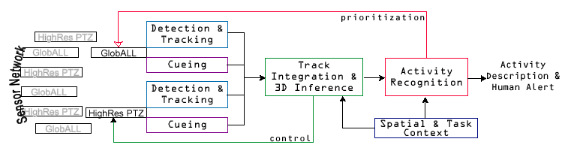
Human activity detection
Nevatia/Medioni/Cohen

Slide 25
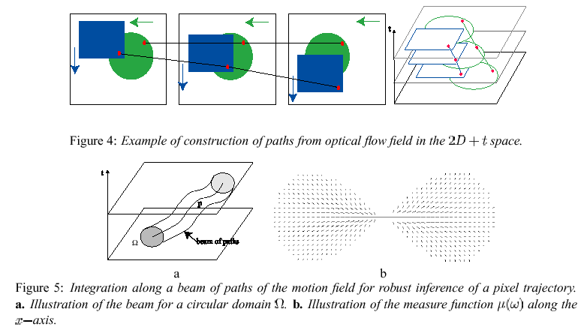
Low-level processing

Slide 26
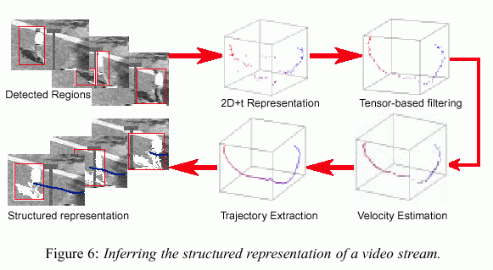
Spatio-temporal representation

Slide 27
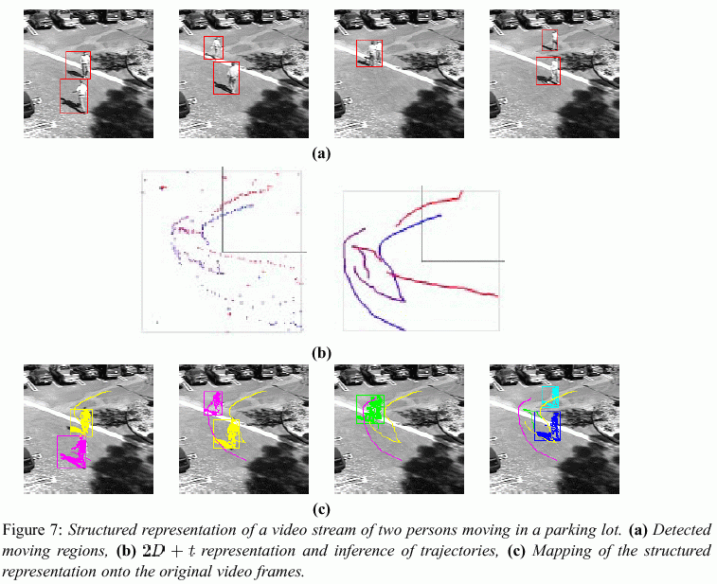

Slide 28
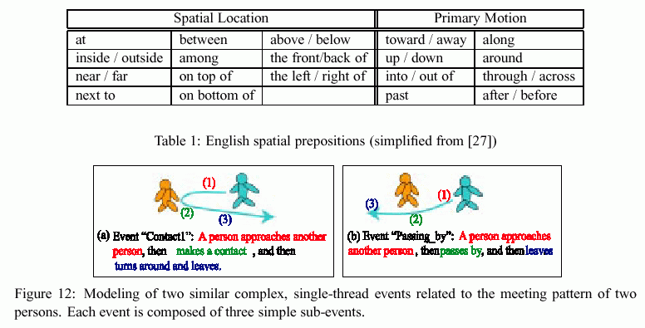
Modeling Events

Slide 29
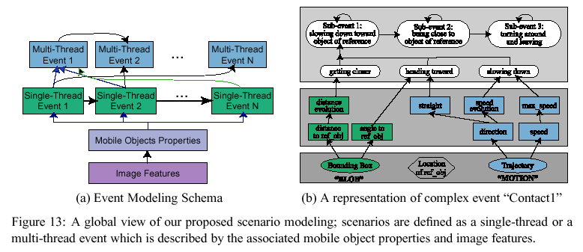
Modeling Events

Slide 30
